Slide 1

Book App
Developed by using
MERN

Slide 2

Contents
1. Group Details
2. Project Objectives
3. Functional Features
4. Block Diagrams
5. Flow Diagrams
6. Snapshots of Project
7. Tools and Techniques
8. Future Scope

Slide 3

Group Details
Group No.02
Group Members:
1.Dawandeep Singh.
2.Pavan Gulaganji.
Group Batch-126 MERN
Group Mentor
Dhiraj Kumar

Slide 4

Project Objectives
This is the project of Book App which is designed and developed using MERN. In our project, we let people search for books of their choice through the author or title based to get book details, and we also display some books on the home page based on different categories to explore more books. If users create an account in our app, we give them an option to add their favorite or important book to the favorites section, so that they can easily access those books.

Slide 5
Functional Features
When user does not have an account,
1.If the user want to register an account, the user can register by filling up all details asked on the registration page.
2.The user can view any book’s details.
3.The user can search any book based on both title and author.

Slide 6
Functional Features
When the user creates an account,
1.They can add any book to their favorite section, and remove them at any time.
2.The user can search any book based on both title and author. If user search any unavailable book or meaningless word, he will get an 404 book not found.
3.The user can see the details of any book by clicking on the book.

Slide 7
Functional Features
When the user creates an account,
4.User can view their profile, in which they will get their info like profile image, name, email, city, phone no.
5.On clicking on the profile icon. The user have an option to change their password.
6.The user by clicking on profile icon, they will get a logout option.

Slide 8
Functional Features
When the user creates an account,
7.If the user forget their password, they have an link i.e forget password on login page, their problem can be resolved through email verification.

Slide 9
Block Diagram
Authentication
Service
(Express JS)
Mongo
DB
FRONT END
(REACT JS)
Favorite
Service
(Express JS)
Mongo
DB
Book
Service
(Express JS)
OpenLibrary
API

Slide 10
Flow Diagram
Register/Login
Profile
Register/Login
USER
(REACT JS)
Search Books
Book Results
Book Details
Access Favorite?
Logged in?
Favorites
YES

Slide 11
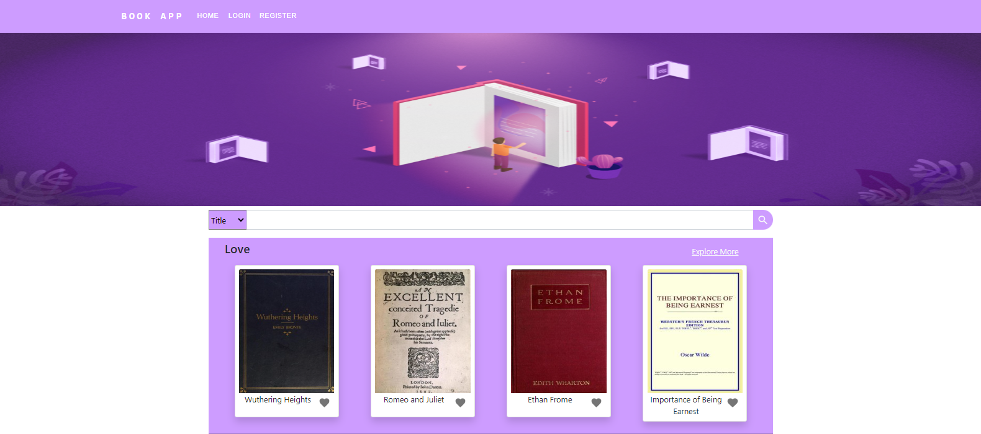
SnapShots of Project
Home page without Login

Slide 12
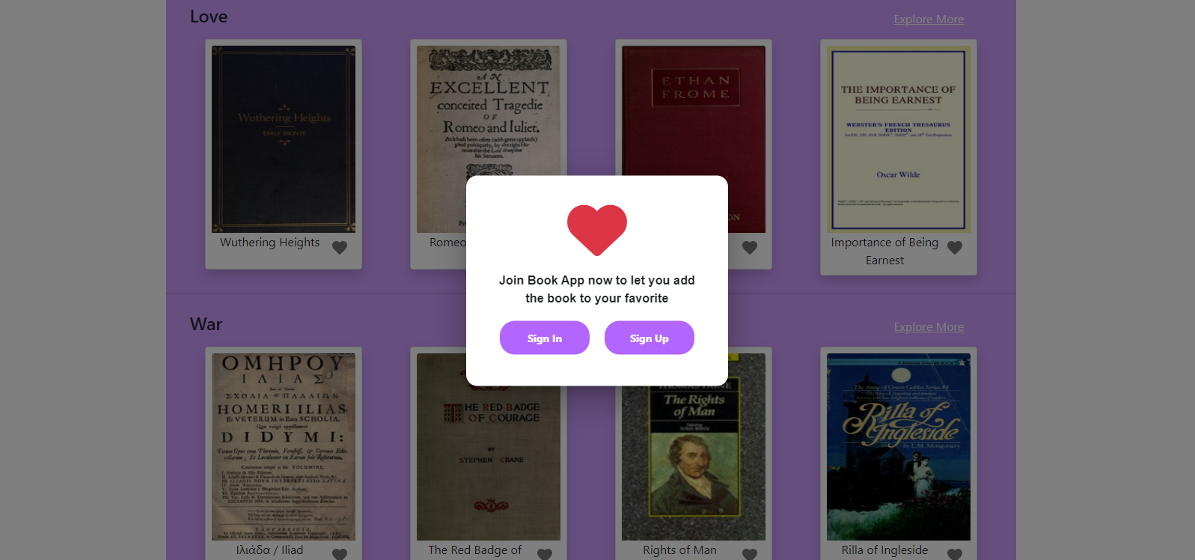
Login to add book to favorite section

Slide 13
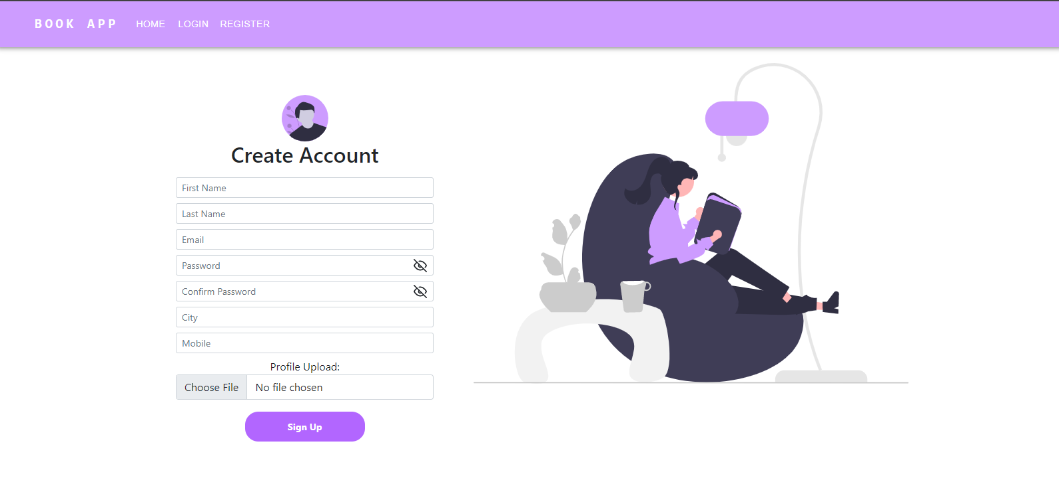
Registration Page

Slide 14
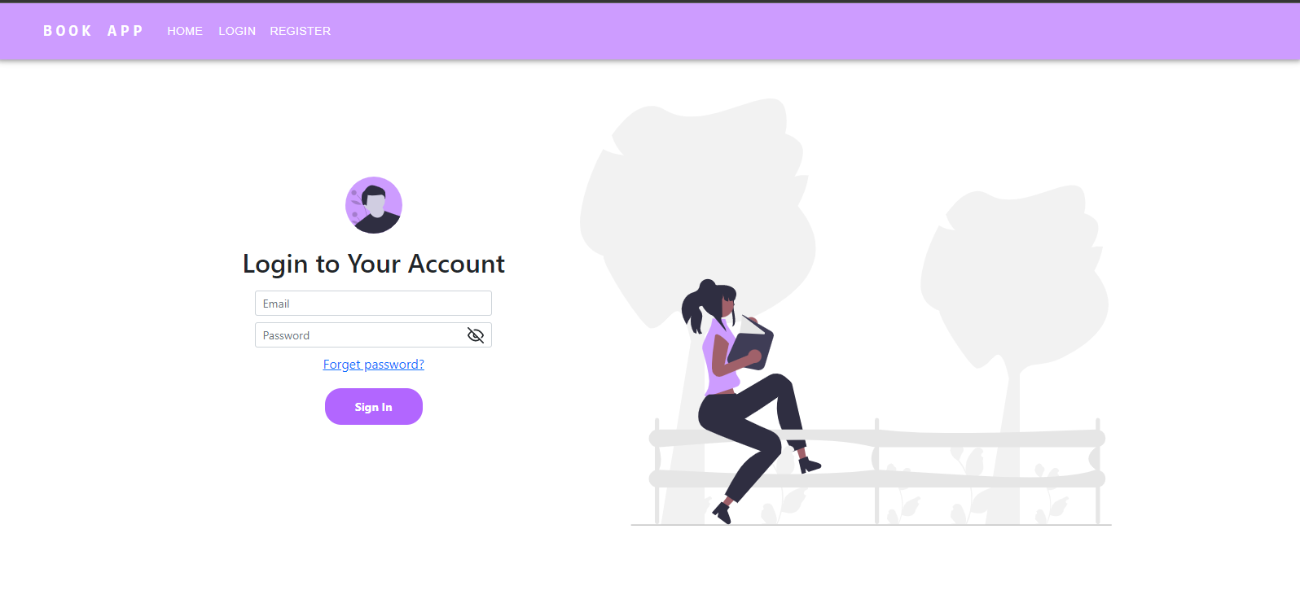
Login Page

Slide 15
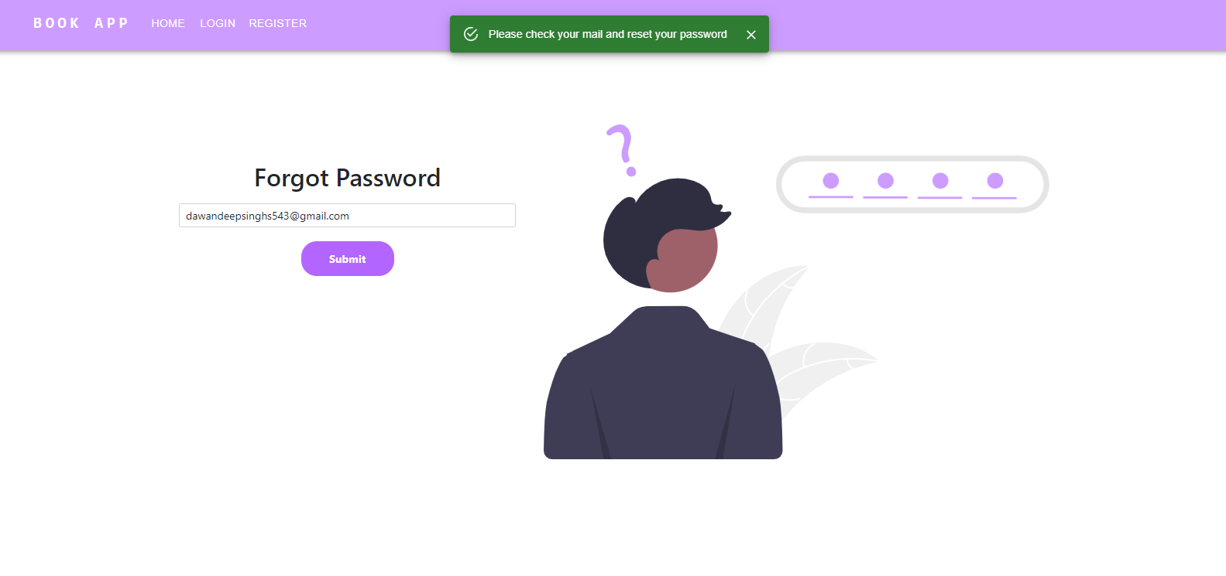
Forget Password?

Slide 16
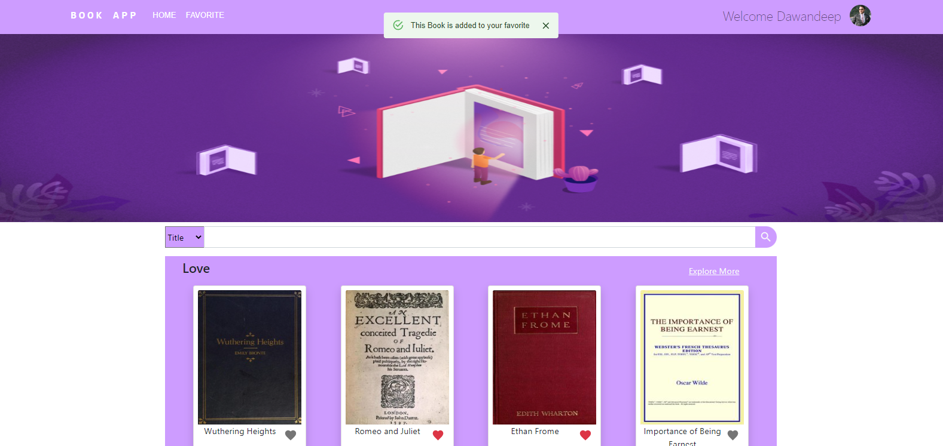
Book added to your Favorite

Slide 17
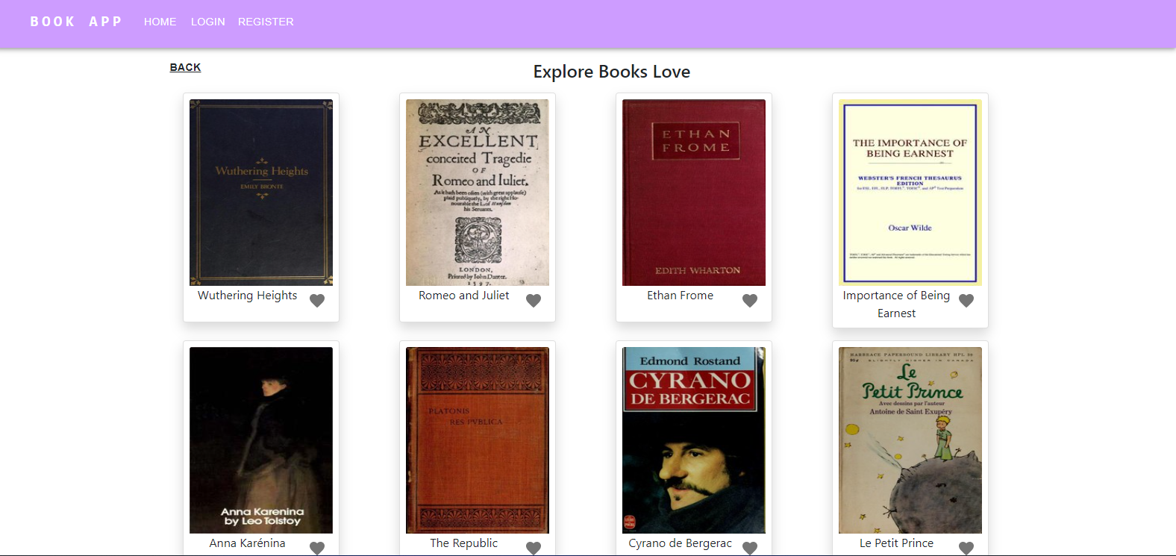
Explore more books

Slide 18
Tools and Techniques
VCS - GitLab​
Source-code Editor - Visual Studio Code​
Backend - NodeJS/ExpressJS​
Frontend - ReactJS​
Data Store - MongoDB​
Testing - Mocha, chai
Container - Docker

Slide 19
Future scope
To make this app as reading platform.
Give provision to buy books and e-books from third party e-commerce sites.
To make users to share book links to others.

Slide 20
Thank you

